Slide 1

Microservices @ Marketplace

Slide 2


Who Are We?
Abhishek
Akshay
Amish
Divya
Hema
Krishna
Mathi
Sairam

Slide 3
Microservices
A Variant of SOA(Service Oriented Architecture)
Collection of Loosely Coupled Services
Parallelized Development, Deploy and Scaling

Slide 4
IDEAs Worth fighting for !!
Authentication As A Service
Wisdom As A Service
Insights As A Service

Slide 5

Authentication As A Service
Basic User Authentication Plus Face Recognition

Slide 6

Wisdom As a service
Provide platform for Reviews and Ratings of all the Products and Services Hosted Online- by certified Users
Wisdom of the Crowd (Many are Smarter than Few)
Find Patterns, Make Informed Decisions

Slide 7

Insights as a service
Fetch Keywords Matching Client's Products/ Services from the User’s Recent Browser History
Show History based product and services offered
Fetch address of the User through GPS/ Zip Code
Provide Location based Insights to Users- Informed Users are Empowered Users. That will Build Advocacy.
(Tax-state/local, Weather, FFM)
Import our Services at Client side Just like CoreMetrics in WCS

Slide 8
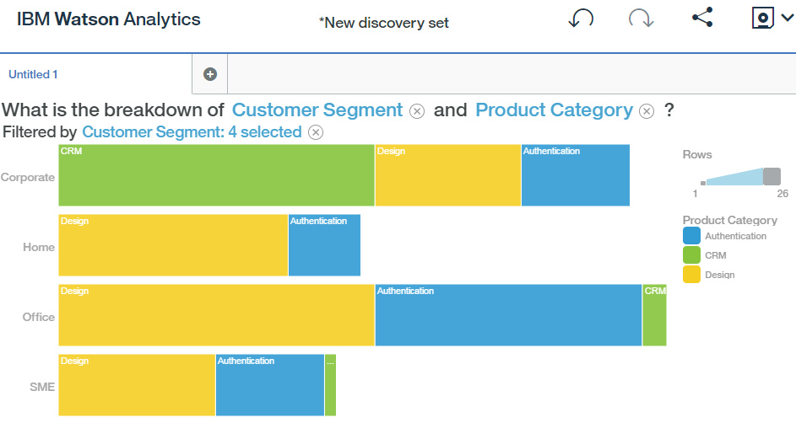
How Watson Can help us ??
Service Categories
Authentication
CRM (WAAS & IAAS)
Design(UI)
Fed Watson Services with our mock data for graphical representation!

Slide 9
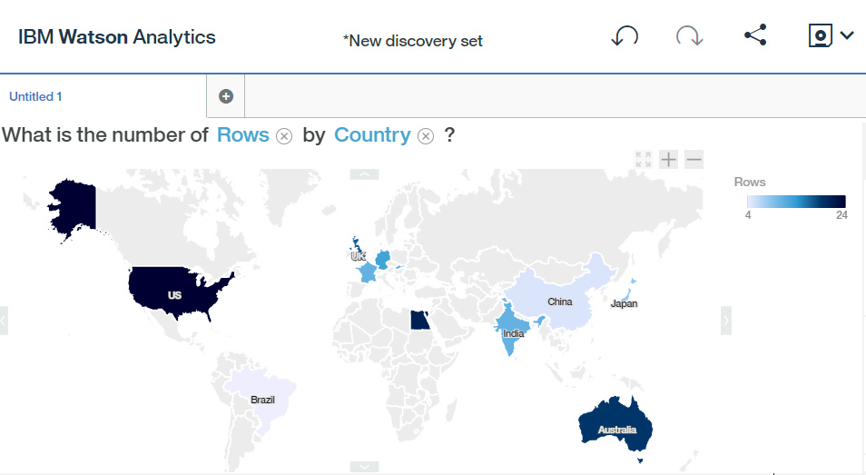
Who buys your Stuff??

Slide 10



Slide 11

Didn’t get it?

Slide 12

Gracias!

